Slide 1
Entity-Relationship Model

Slide 2
Introduction to Data Models
In a Database Management System (DBMS), a data model is a conceptual framework that determines how data is stored, connected, and manipulated. It provides the structure for a database and defines how data elements relate to each other.
Definition of Data Model:
A data model is a collection of conceptual tools for describing data, data relationships, data semantics, and data constraints.

Slide 3
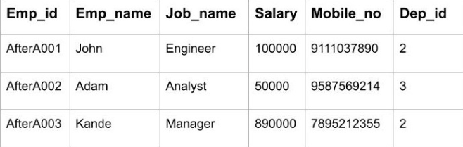
Types of Data Models
Relational Data Model:

Slide 4
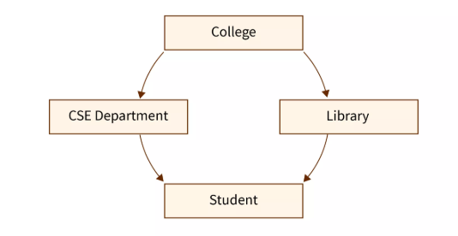
Types of Data Models
Network Model

Slide 5
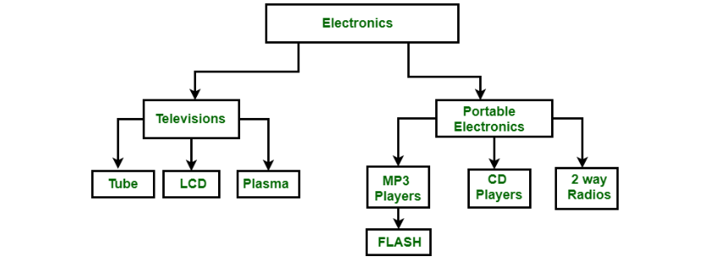
Types of Data Models
Hierarchical Data Model

Slide 6
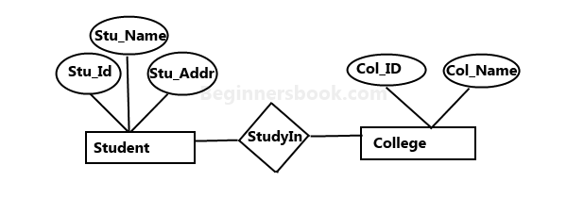
Types of Data Models
Entity-Relationship (ER) Model:

Slide 7
Basic Concepts (entities, attributes, entity sets, relations, relationship sets)
What is an Entity?
An Entity represents a real-world object, concept or thing about which data is stored in a database. It act as a building block of a database. Tables in relational database represent these entities.
Example of entities:
Real-World Objects: Person, Car, Employee etc.
Concepts: Course, Event, Reservation etc.
Things: Product, Document, Device etc.

Slide 8
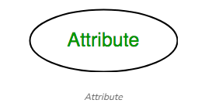
Basic Concepts (entities, attributes, entity sets, relations, relationship sets)
Attributes
Entities are represented by means of their properties, called attributes. All attributes have values. For example, a student entity may have name, class, and age as attributes.

Slide 9
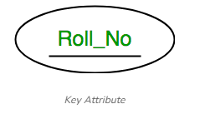
Basic Concepts (entities, attributes, entity sets, relations, relationship sets)
Types of Attribute:
Key Attribute
The attribute which uniquely identifies each entity in the entity set is called the key attribute. For example, Roll_No will be unique for each student.

Slide 10
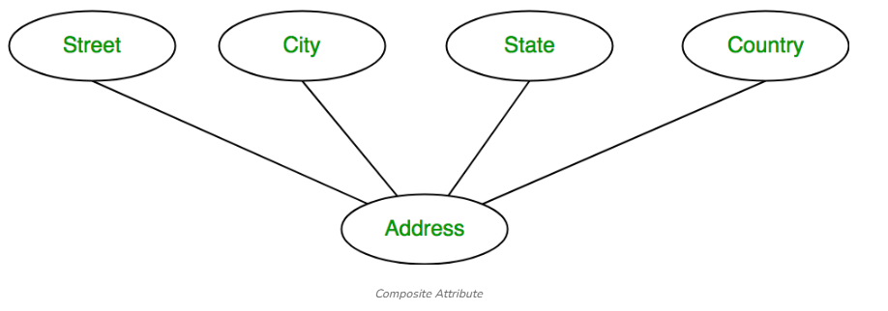
Basic Concepts (entities, attributes, entity sets, relations, relationship sets)
Composite Attribute:
An attribute composed of many other attributes is called a composite attribute. For example, the Address attribute of the student Entity type consists of Street, City, State, and Country.

Slide 11
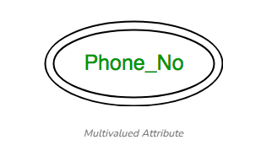
Basic Concepts (entities, attributes, entity sets, relations, relationship sets)
Multivalued Attribute:
An attribute consisting of more than one value for a given entity. For example, Phone_No (can be more than one for a given student).

Slide 12
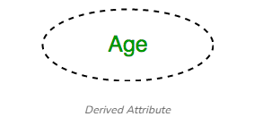
Basic Concepts (entities, attributes, entity sets, relations, relationship sets)
Derived Attribute
An attribute that can be derived from other attributes of the entity type is known as a derived attribute. e.g.; Age (can be derived from DOB).

Slide 13
Basic Concepts (entities, attributes, entity sets, relations, relationship sets)
What is an Entity Set?
An Entity Set is a collection of similar entities that share the same attributes. Each entity in the set represents a real-world object.
Example:
Student
Represents all students in a school or university.
Attributes: StudentID, Name, Email, DateOfBirth
(1, "Alice", "alice@email.com", "2002-04-15")
(2, "Bob", "bob@email.com", "2001-09-03")

Slide 14
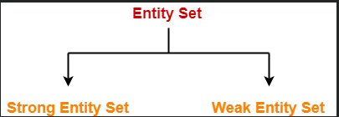
Basic Concepts (entities, attributes, entity sets, relations, relationship sets)
Types of Entity Set:
1. Weak Entity Set:
A weak entity cannot exist on its own; it is dependent on a strong entity to identify it. A weak entity does not have a single primary key that uniquely identifies it; instead, it has a partial key.

Slide 15
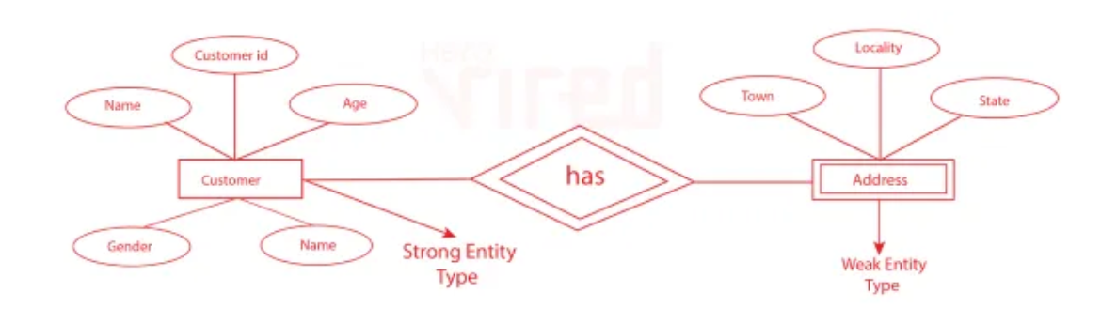
Basic Concepts (entities, attributes, entity sets, relations, relationship sets)
2. Strong Entity Set:
Strong entity sets exist independently and each instance of a strong entity set has a unique primary key.

Slide 16
Basic Concepts (entities, attributes, entity sets, relations, relationship sets)
Relationship:
A relationship is represented by diamond shape in ER diagram, it shows the relationship among entities. There are four types of relationships: 1. One to One 2. One to Many 3. Many to One 4. Many to Many

Slide 17
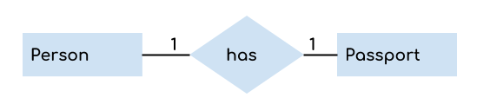
Basic Concepts (entities, attributes, entity sets, relations, relationship sets)
One to One Relationship
When a single instance of an entity is associated with a single instance of another entity then it is called one to one relationship. For example, a person has only one passport and a passport is given to one person.

Slide 18

Basic Concepts (entities, attributes, entity sets, relations, relationship sets)
One to Many Relationship
When a single instance of an entity is associated with more than one instances of another entity then it is called one to many relationship. For example – a customer can place many orders but a order cannot be placed by many customers.

Slide 19
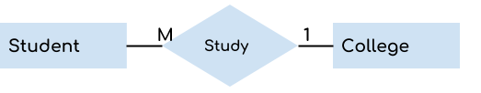
Basic Concepts (entities, attributes, entity sets, relations, relationship sets)
Many to One Relationship
When more than one instances of an entity is associated with a single instance of another entity then it is called many to one relationship. For example – many students can study in a single college but a student cannot study in many colleges at the same time.

Slide 20
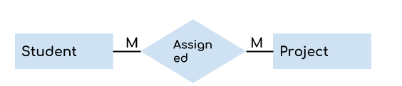
Basic Concepts (entities, attributes, entity sets, relations, relationship sets)
Many to Many Relationship
When more than one instances of an entity is associated with more than one instances of another entity then it is called many to many relationship. For example, a can be assigned to many projects and a project can be assigned to many students.

Slide 21
Example
The following information stored in the database:
Customer: name, address, gender and preferred sport
Supplier: Supplier identification number, price per unit, amount in the inventory.
Product: Product ID, price per unit, amount in the inventory.
A Customer may order one or more products, and a product may be ordered by one or more customers. Additionally, product may be provided by one or more suppliers, and a supplier may provide more than one product.

Slide 22
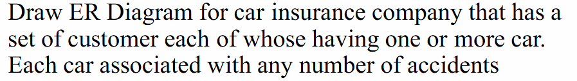
Example
In a university, a Student enrolls in Courses. A student must be assigned to at least one or more Courses. Each course is taught by a single Professor. To maintain instruction quality, a Professor can deliver only one course

Slide 23
Practice Set
A female can marry to one male, and a male can marry to one female.
Scientist can invent many inventions, but the invention is done by the only specific scientist.
Student enrolls for only one course, but a course can have many students.
Employee can assign by many projects and project can have many employees.
An employee can work in many departments (≥ 0), and a department can have several employees(Many-To-Many)
An employee can work in at most one department, and a department can have at most one employee.( One-To-One)

Slide 24
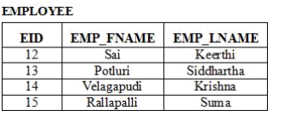
Constraints
Primary Key:
It is an attribute or set of attributes that uniquely identify an entity (row) in the entity set (table).

Slide 25
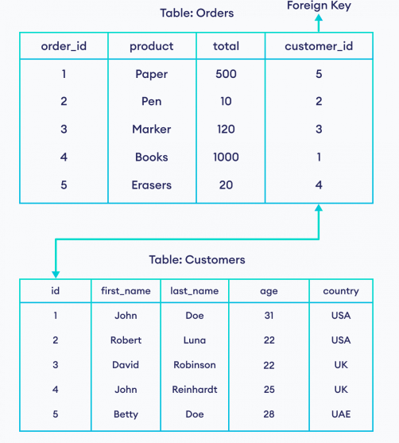
Constraints
Foreign Key (Referential Constraints):
A foreign key is a set of attributes in a table that refers to the primary key of another table.

Slide 26
Constraints
Unique Key :
A column or set of columns in a database system that uniquely identifies each tuple in the table is called a unique key.
Example:
Let's consider one example of books in the library. In the library, each book has a unique identification number called ISBN(International Standard Book Number). Just like how each book in the library has its own ISBN which ensures that no two books are similar. In the same way in the database of customers, everyone has their unique email id so from that we can get to know about that customer in detail. So these examples illustrate the concept of unique identification in a database system. So ISBN for the book and email ID for a customer here work as a unique key.

Slide 27
Difference Between Primary Key and Unique Key:
Primary Key | Unique Key
A primary key cannot have a NULL value. | Unique keys can have one NULL value.
The table can have only one primary key. | The table can have more than one unique key.
Any change in primary key value may necessitate updates in related tables to maintain referential integrity. | A unique key can be updated or deleted, it doesn't affect the table's integrity constraints.
In some databases, the primary key can generate a clustered index by default. | In some databases, a unique key can generate a non-clustered index by default.

Slide 28
NOT NULL Constraint
The NOT NULL constraint is used to enforce that a column in a table must always contain a value; it cannot contain a NULL value.

Slide 29
Examples
The entities in this ER model are Employee, Department and Project. These entities have the following attributes −
Employee - ENO(Primary Key) , Name, Salary
Department - DNO(Primary key), Name, Locations
Project - PNO(Primary key), Name

Slide 30
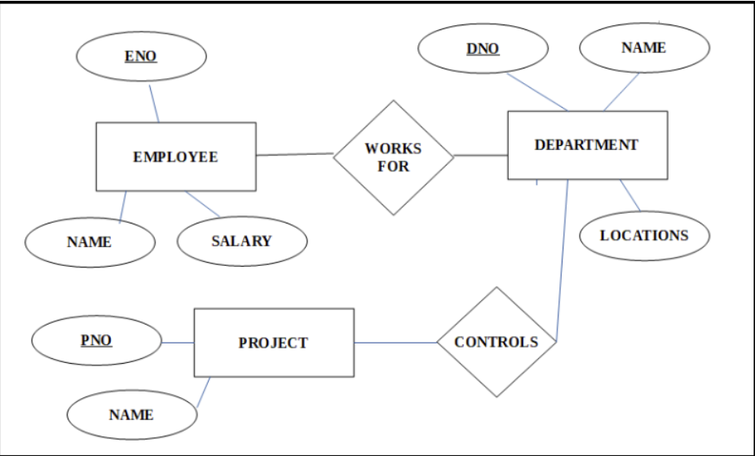
Examples

Slide 31
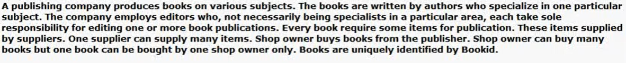
Example:

Slide 32
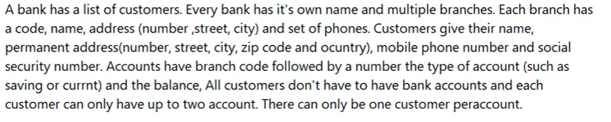
Example

Slide 33
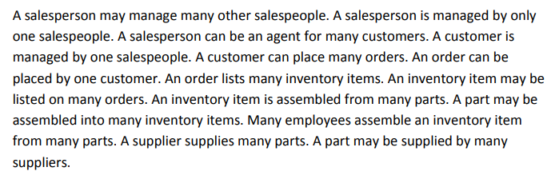
Example

Slide 34
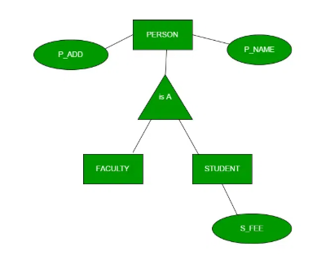
Extended E- R Features:
Generalization
Generalization is the process of extracting common properties from a set of entities and creating a generalized entity from it. It is a bottom-up approach in which two or more entities can be generalized to a higher-level entity if they have some attributes in common. For Example, STUDENT and FACULTY can be generalized to a higher-level entity called PERSON as shown in Figure 1. In this case, common attributes like P_NAME, and P_ADD become part of a higher entity (PERSON), and specialized attributes like S_FEE become part of a specialized entity (STUDENT).

Slide 35
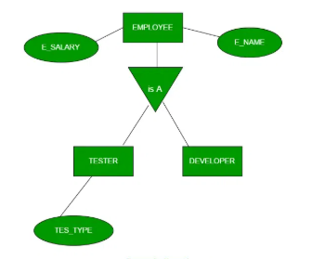
Extended E- R Features:
Specialization
In specialization, an entity is divided into sub-entities based on its characteristics. It is a top-down approach where the higher-level entity is specialized into two or more lower-level entities. For Example, an EMPLOYEE entity in an Employee management system can be specialized into DEVELOPER, TESTER, etc. as shown in Figure 2. In this case, common attributes like E_NAME, E_SAL, etc. become part of a higher entity (EMPLOYEE), and specialized attributes like TES_TYPE become part of a specialized entity (TESTER).

Slide 36
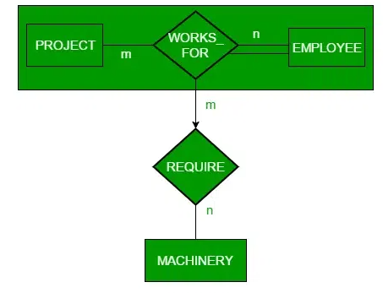
Extended E- R Features:
Aggregation
An ER diagram is not capable of representing the relationship between an entity and a relationship which may be required in some scenarios. In those cases, a relationship with its corresponding entities is aggregated into a higher-level entity. Aggregation is an abstraction through which we can represent relationships as higher-level entity sets.
For Example, an Employee working on a project may require some machinery. So, REQUIRE relationship is needed between the relationship WORKS_FOR and entity MACHINERY. Using aggregation, WORKS_FOR relationship with its entities EMPLOYEE and PROJECT is aggregated into a single entity and relationship REQUIRE is created between the aggregated entity and MACHINERY.

